Slide 1
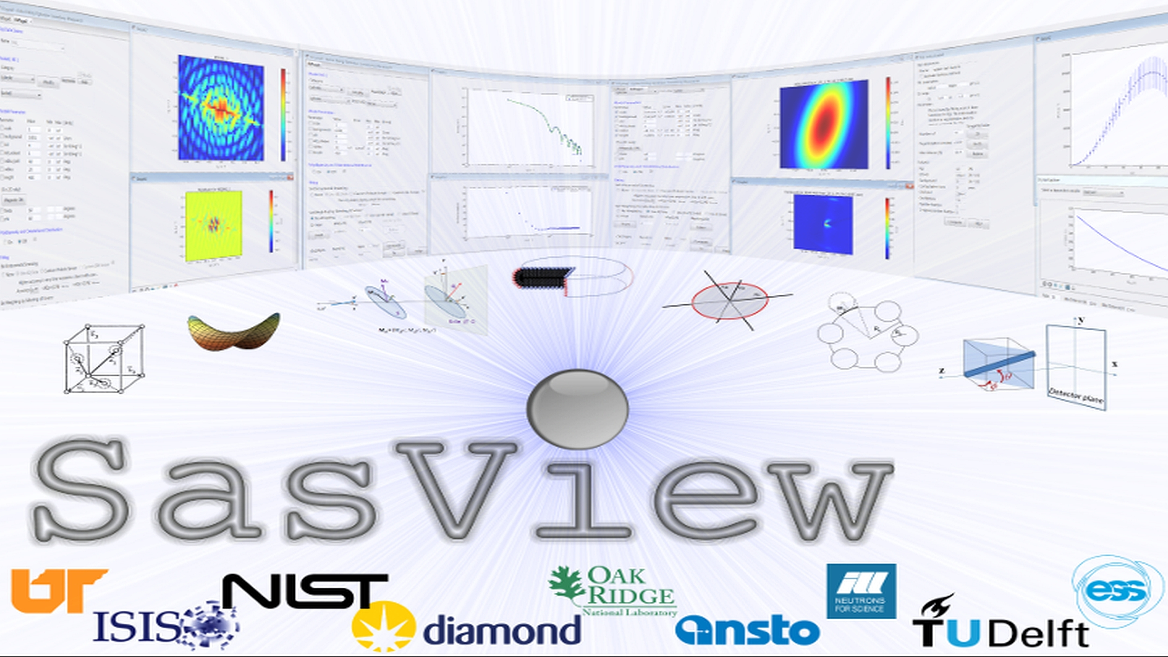
Addressing the Resource Problem Through Community

Slide 2
The resource Problem Part I
Analysis? Let's define that
"Works on data from which all instrumental artifacts have been removed"
…. sortof
Instrument Independent Data
$$MONEY$$
Source Construction
Reduction Sofware
Civil Construction
Data Hardware
Analysis
Software??
Instruments
Time

Slide 3
The resource Problem Part I
Analysis Software - Who’s Job is it Anyway?
Scattering is an analysis tool and part of providing the tool should be the necessary software
→ the FACILITY’S JOB
$$MONEY$$
Analysis is where the science is
→ the USER’S JOB
Source Construction
Reduction Sofware
Civil Construction
Data Hardware
Analysis
Software??
Instruments
Or maybe …..
→ The Domain Science funding agencies?
Time

Slide 4
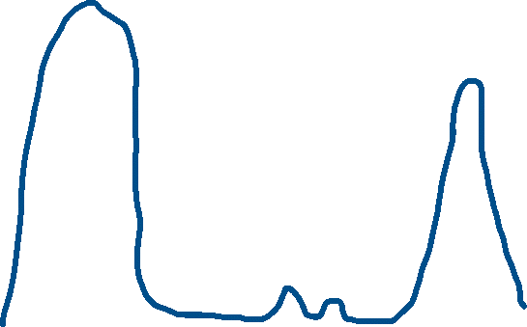
The resource Problem Part II
The feast and famine roller coaster
The Valley(s) of death
Analysis Software - Who’s Job is it Anyway?
- The domain science funding agencies
Facility directors discretion, NIH, NSF, DOE, etc.
Special funding (grants) do no fund long term maintenance and ongoing development. They fund “big new (transformative) ideas”
$$MONEY$$
Time

Slide 5
The resource Problem Part III
The unbounded problem
Fundamentally all these elements are relatively well defined problems…
EXCEPT ...
Analysis Software is really unbounded. The needs are nearly infinite and constantly evolving.
$$MONEY$$
Source Construction
Reduction Sofware
Civil Construction
HOWEVER --- Analysis as defined here is also uniquely universal and ripe for collaborative pooling of finite resources
…. But beware the monoculture?
Data Hardware
Analysis
Software??
Instruments
Time

Slide 6
The resource Problem Reframed – The Need
A way to focus limited resources on top priorities (most useful to the science being done) in a world of infinite possibilities
A way to harness funding for bold new ideas without losing the investment in the valleys of death
A way to provide sustained maintenance and development in an uncertain funding environment (thriving through the famines)
FACTS OF LIFE:
Resources are finite
Needs are infinite

Slide 7










The SasView Aproach
An
“open, collaborative, community development”
platform for
Small Angle Scattering Data Analysis

Slide 8
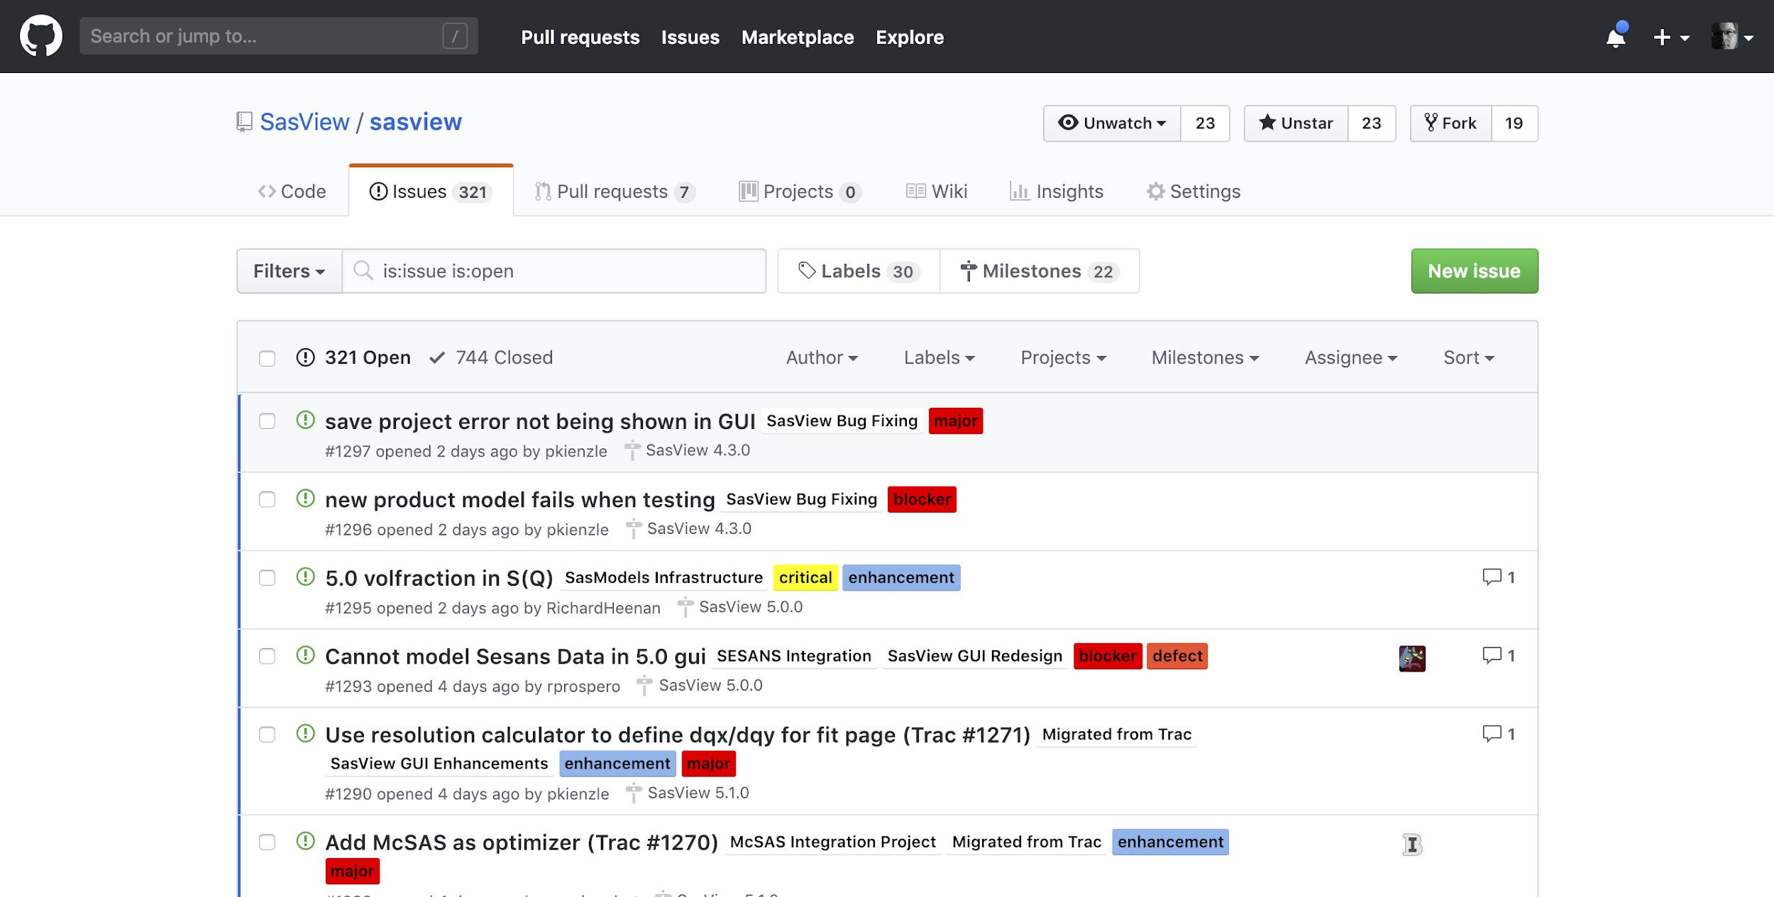
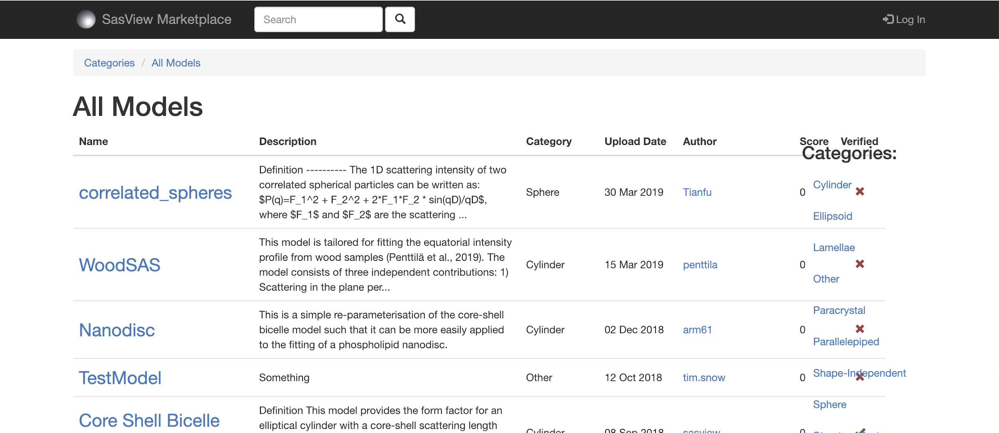



Open, Collaborative, Community Development
Code is open source and publicly hosted at Github
Released under BSD 3-clause license
(Zenodo) DOI for each release
Website
Documentation: in-program & online
Written Tutorials
Video Tutorials (YouTube)
scattering schools/workshop
university courses
Bootcamps & regional workshops
Twitter
help@sasview.org
users@sasview.org
Rolling 5 Year Roadmap
Code Hosting, Issue Tracking, Developer Wiki & CI on Public Github repos
Model Marketplace for Users to share their models
https://github.com/SasView
http://marketplace.sasview.org
https://www.sasview.org

Slide 9
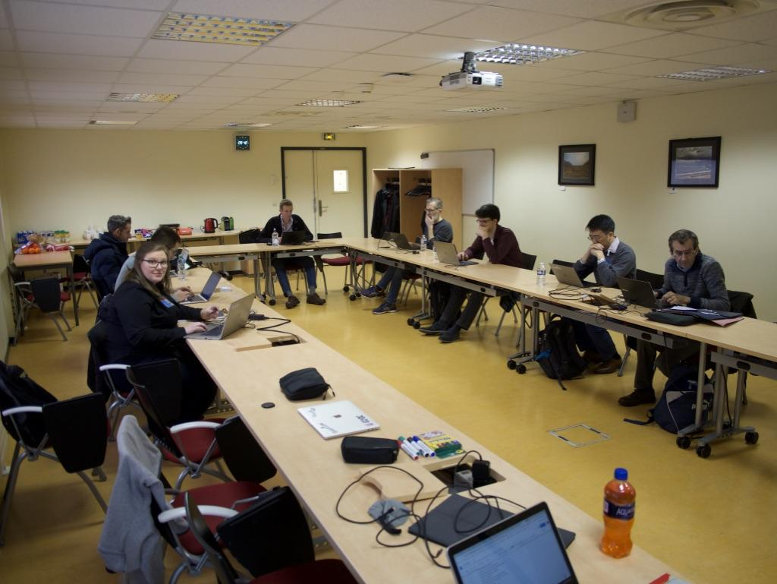
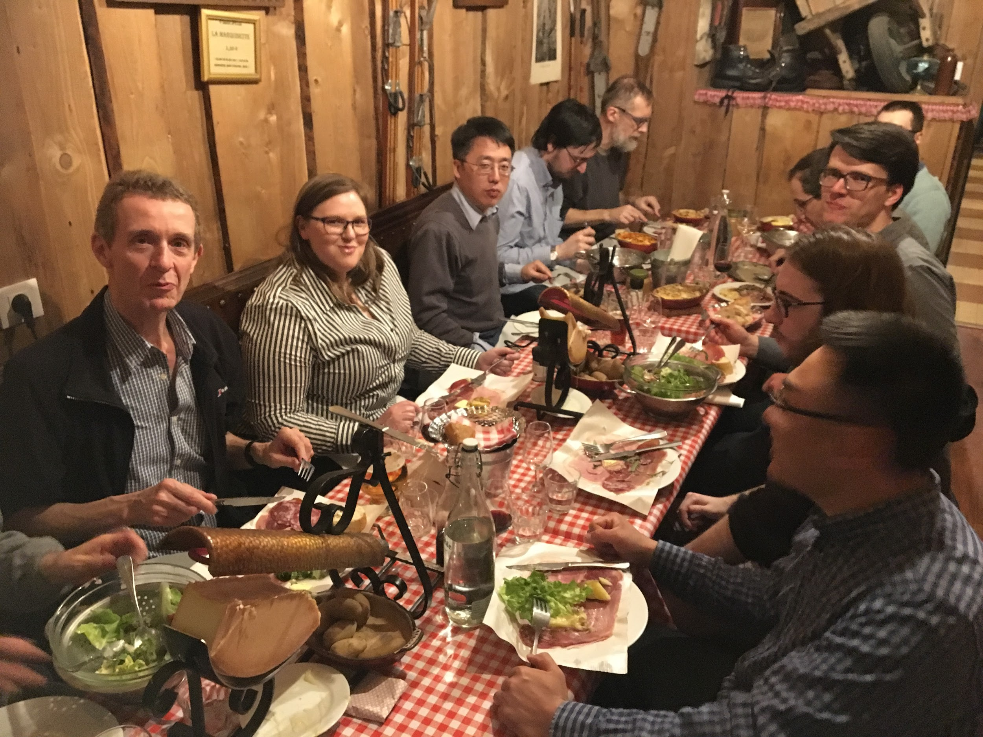
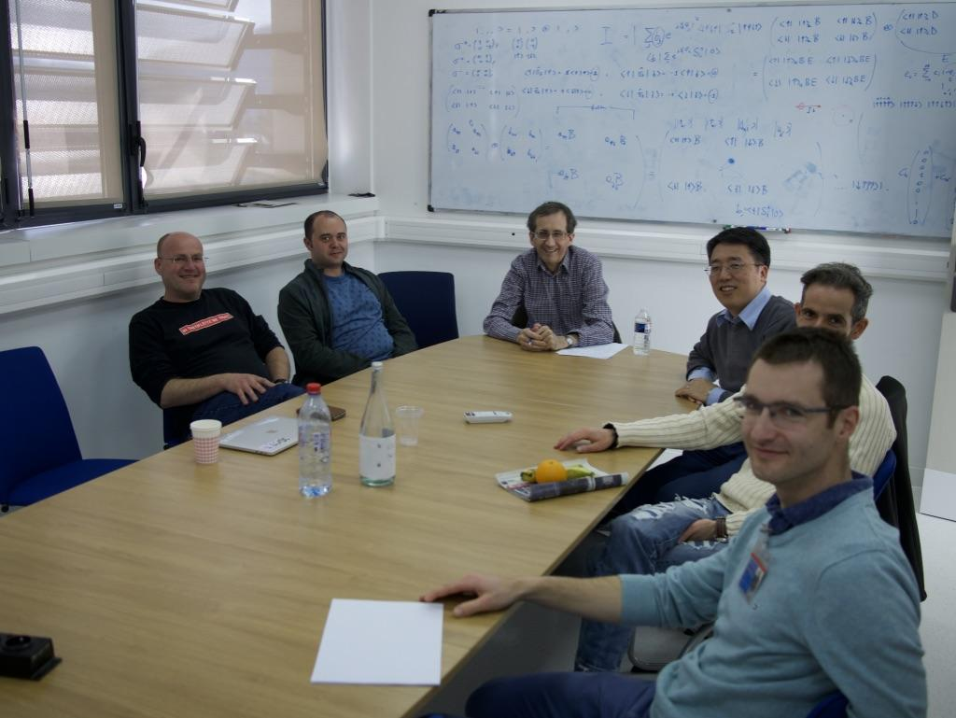
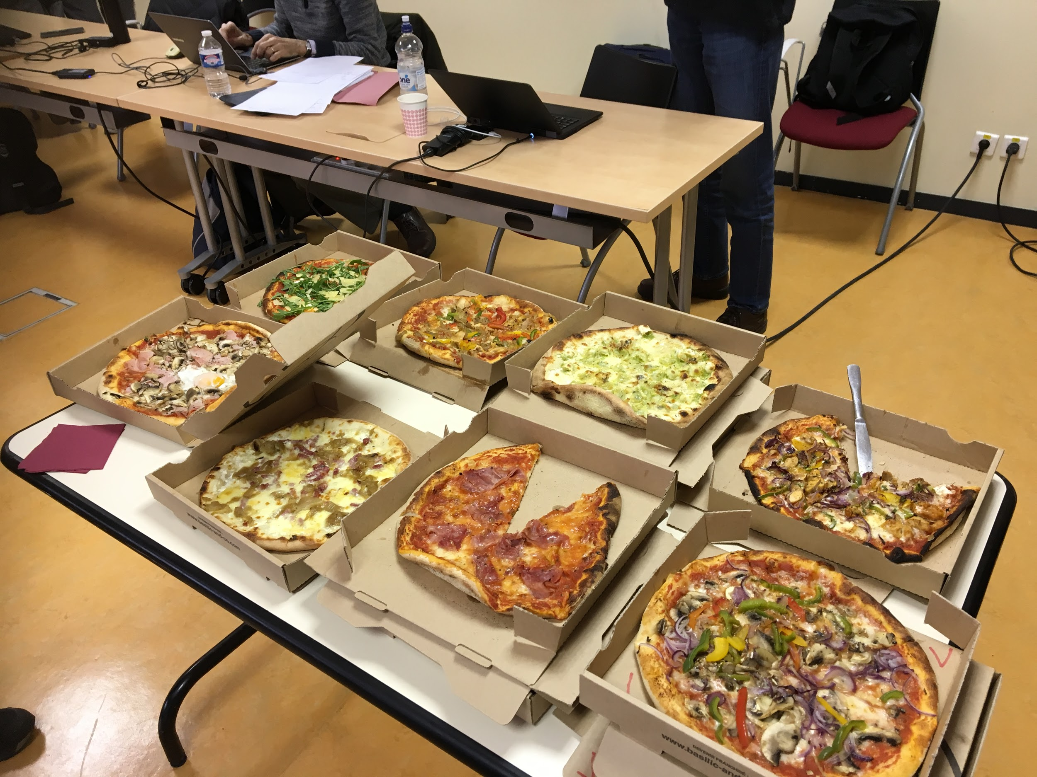
Open, Collaborative, Community Development
Twice monthly zoom calls
Regular ‘camps’ & ‘hackathons’
Developer's mailing list
SasView slack
Expertise sharing and helping
Small leadership team to facilitate
Collaboration also builds
Community
http://www.sasview.org
http://github.com/SasView

Slide 10
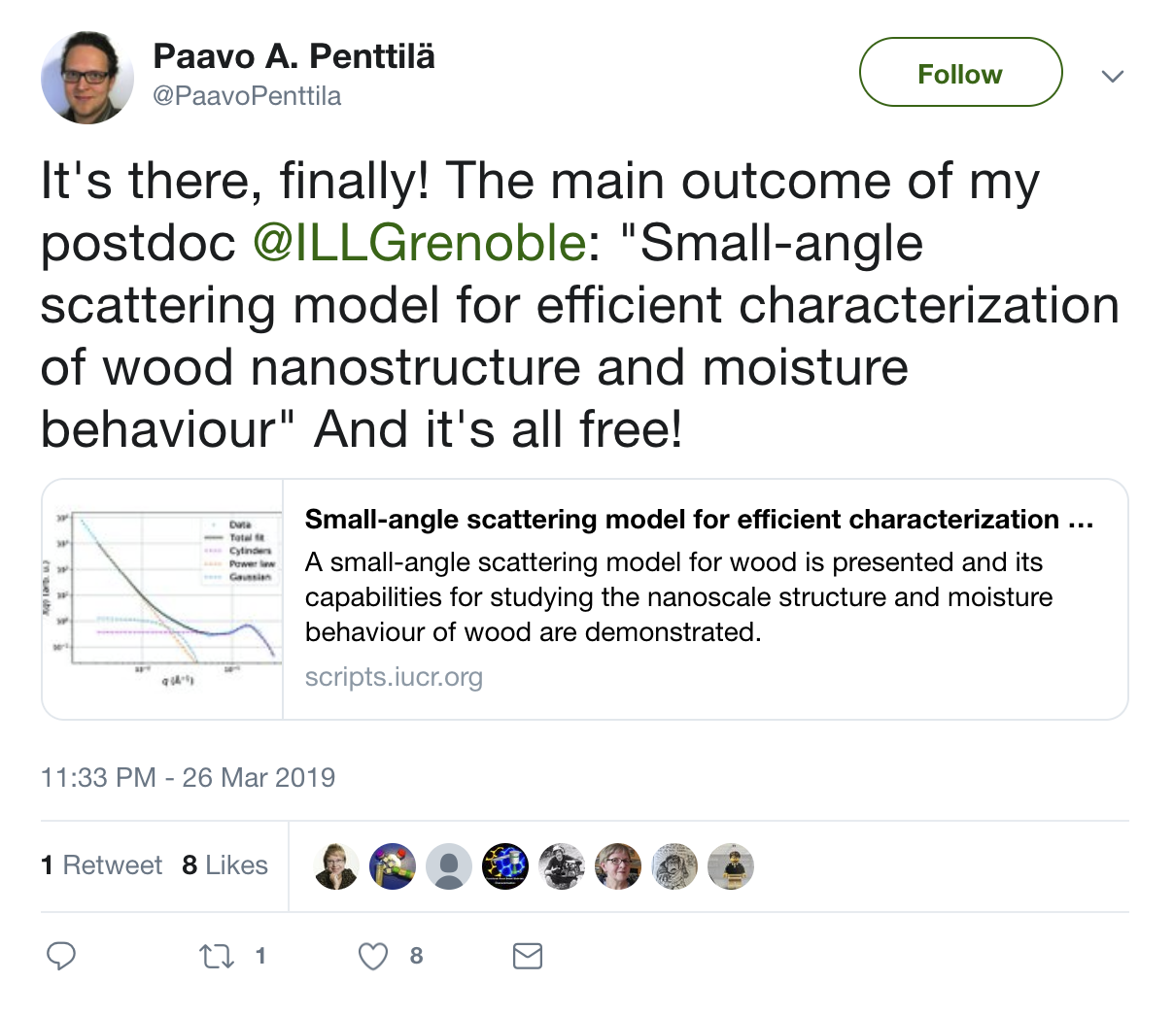
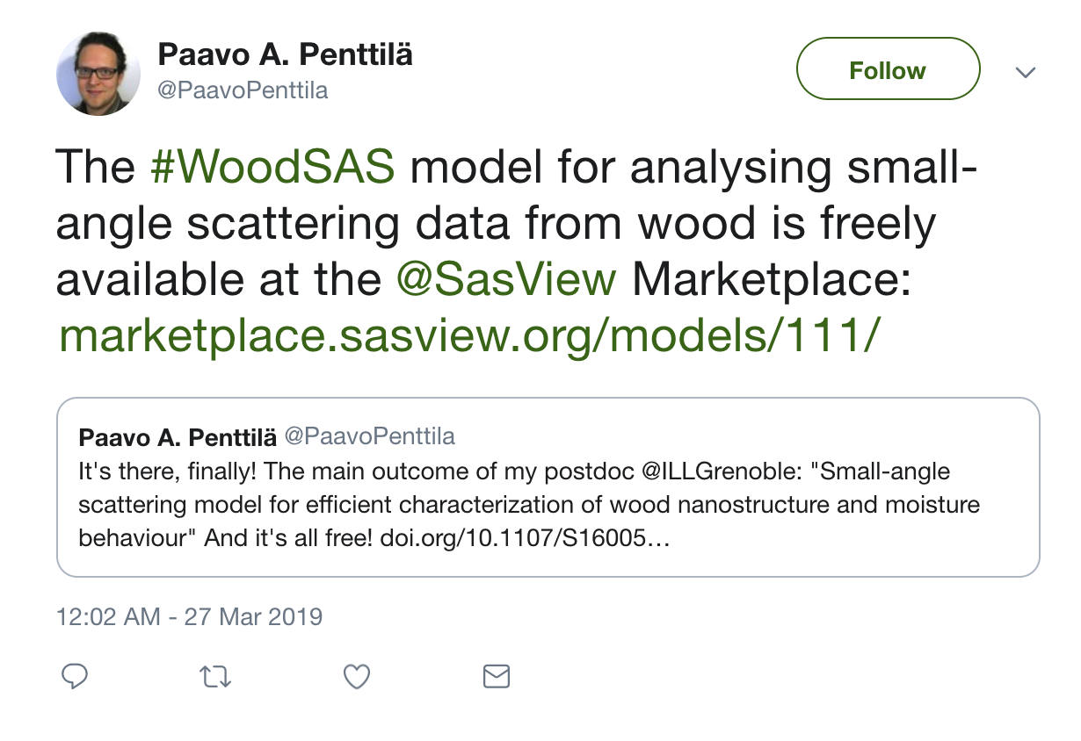
Open, Collaborative, Community Development
Ask not what the community is going to do for you,
ask what you can do for the community
P. Butler, March 2019
No MOU ... all are invited and welcome
Two Basic "Rules"
He who pays the piper gets to choose the tune…
Those who bring the resources (time and effort, or funds to buy time and effort) choose what to work on.
And ...
You cannot break existing experiences ...
New dependencies vs long term maintenance (sustainability)
Code quality vs long term sustainability
Changing/degrading the current user experience for the existing user base
http://www.sasview.org
http://github.com/SasView

Slide 11
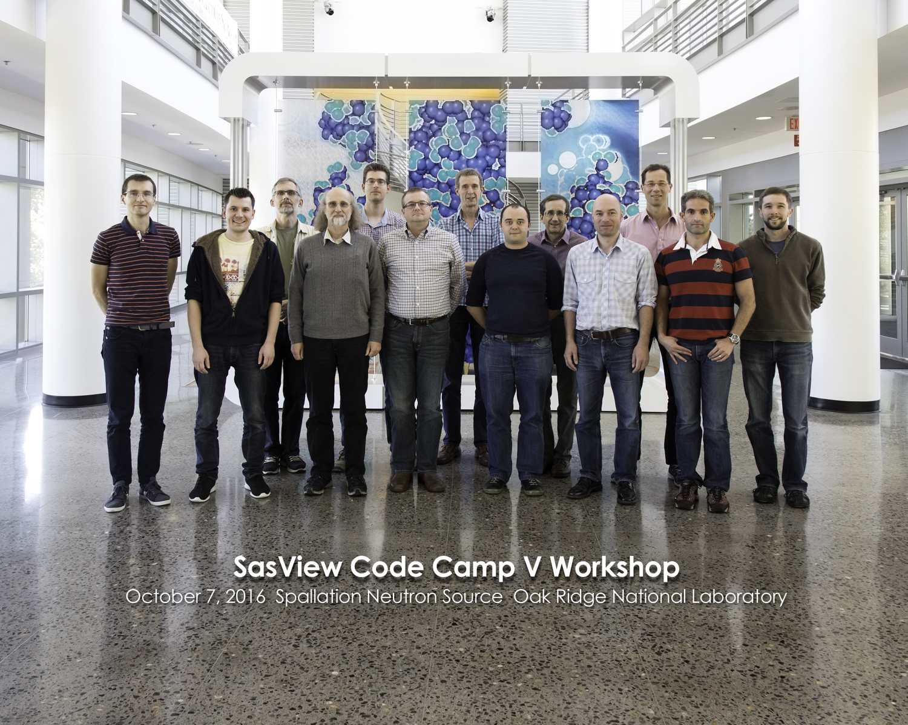
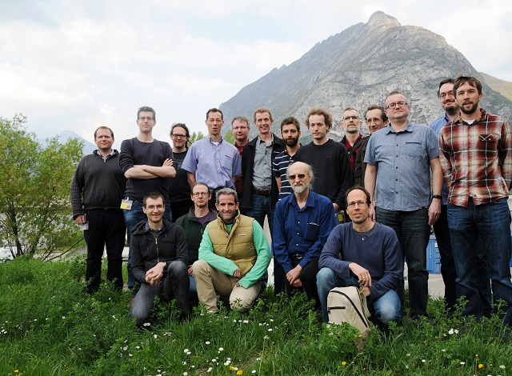
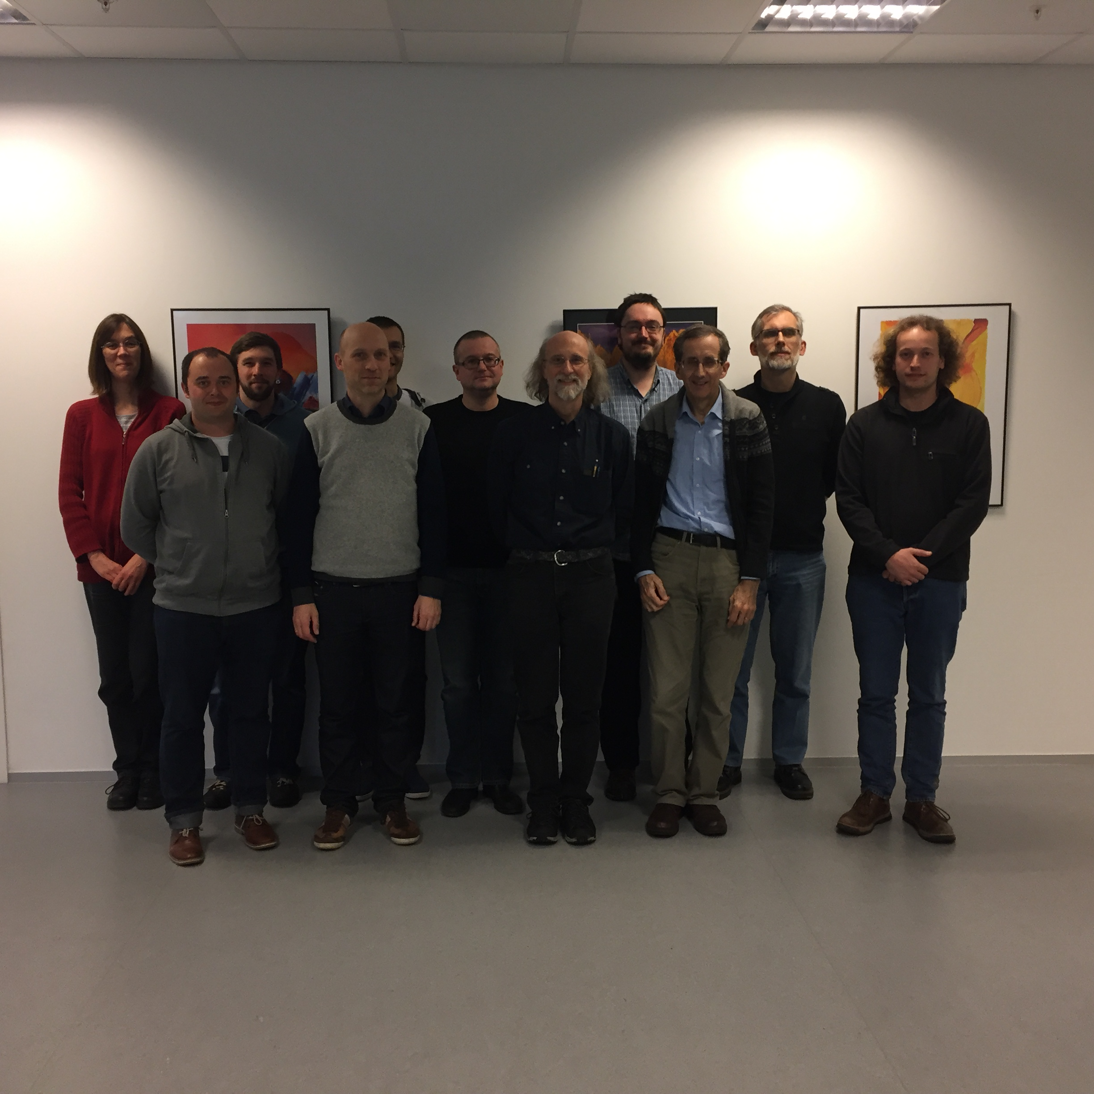
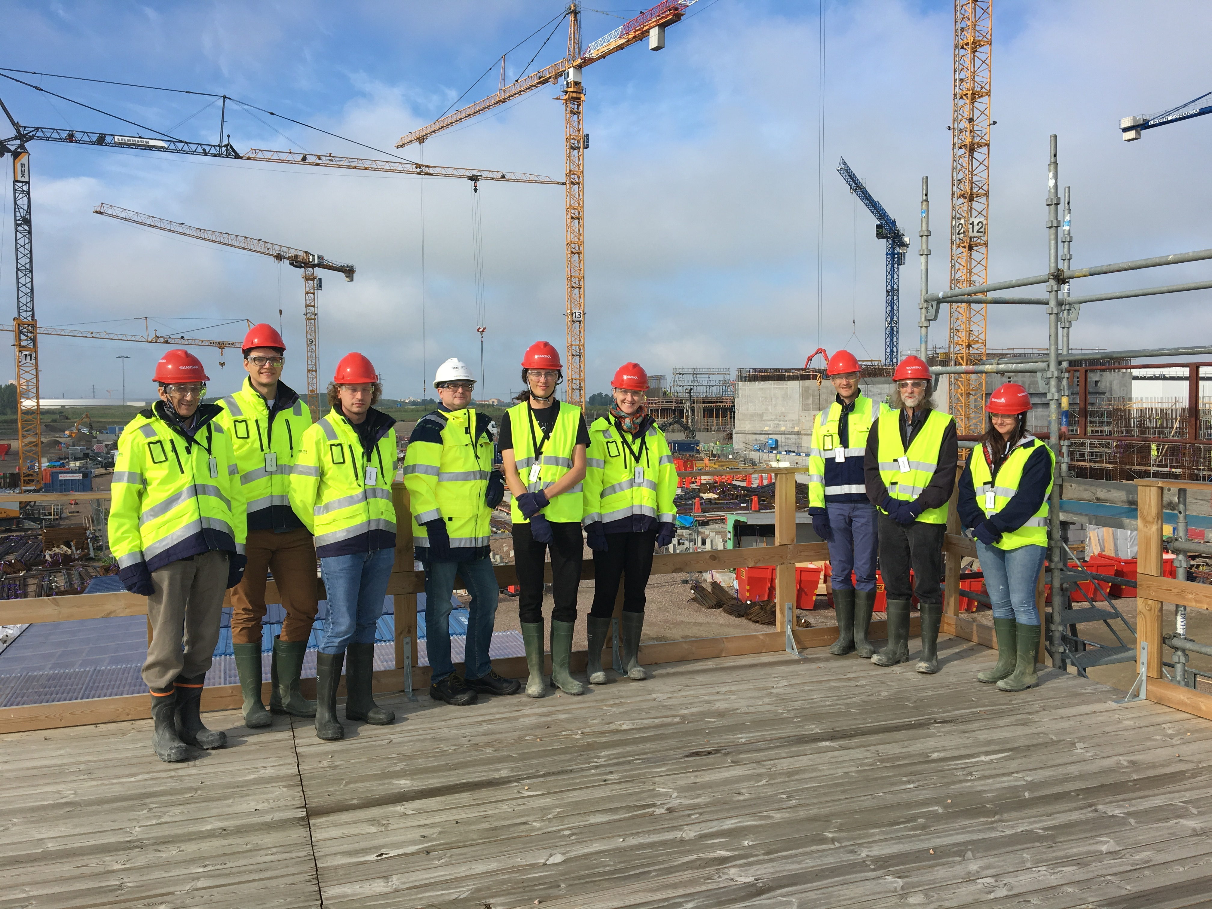
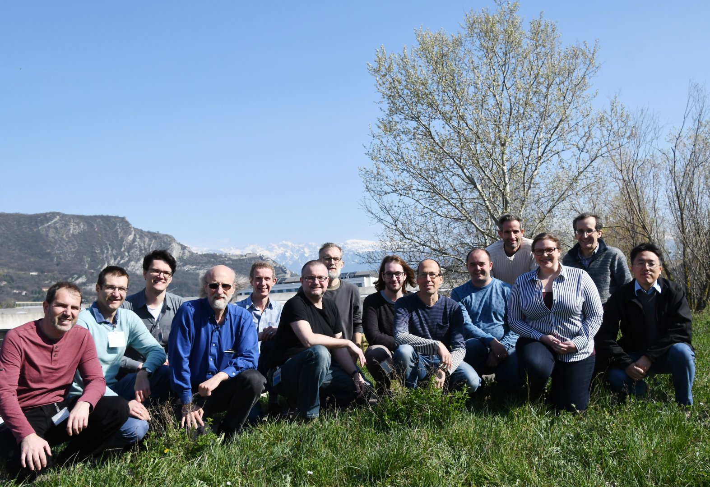
History and Status of SasView
2006; originates in NSF DANSE project
2013; transitions into a community project
2016; Sine2020 project funded
2022; Essentially a “volunteer army”
--------------------
~40 contributors from 9 organizations so far (~10-15 active at any one time)
1 to 2 releases/year (5.0.5 JUST RELEASED)
Documentation/tutorial projects ongoing
Usage? Seems to be "everywhere?"
Publications? > 100/year

Slide 12
SasView Model: Some Current Problems
The price of success:
Some general issues:
Many people view the project as a well-funded group of professionals → barrier to contribution.
Large project with many moving pieces is a barrier to new volunteer coders
Cost of writing sustainable/maintainable code is surprisingly high and can be a deterrent to new contributors
The tragedy of the commons: somebody else will take care of the problem.
Hard to get non-coders to believe they can contribute equally – it is unfortunately in the name “code camp” … words matter → SasView camp?
Building community, especially during a pandemic is HARD WORK
Lack of funds for small things … but beware too much money?
Hard to keep up with increasing security issues with these resources so far.

Slide 13
The resource Problem Reframed – The Solution
Facilities provide foundational support through participation of data and instrument scientists
Grants and other projects provide “bold new functionality”
Community, writ large, helps provide support and functionality
New ideas tested and developed as before by individuals or larger groups (the community)
Once validated and deemed ready for the larger community these groups provide resources (their labor) to integrate while active developer community helps with training on where things go and on parts of interest to them (collaborative)
Thoughts? Ideas? Suggestions? I'd love to talk to anyone interested

